Slide 1
UNIT-V Multithreading in Java

Slide 2
Unit 3: Syllabus
MultiThreading: Java Thread Model, Main Thread, Creating a Thread , Creating Multiple Threads.

Slide 3
Multithreading in Java
Multithreading in Java is a process of executing multiple threads simultaneously.
A thread is a lightweight sub-process, the smallest unit of processing. Multiprocessing and multithreading, both are used to achieve multitasking.
However, we use multithreading than multiprocessing because threads use a shared memory area. They don't allocate separate memory area so saves memory, and context-switching between the threads takes less time than process.

Slide 4
Advantages of Java Multithreading
It doesn't block the user because threads are independent and you can perform multiple operations at the same time.
You can perform many operations together, so it saves time.
Threads are independent, so it doesn't affect other threads if an exception occurs in a single thread.

Slide 5
Multitasking
Multitasking is a process of executing multiple tasks simultaneously. We use multitasking to utilize the CPU. Multitasking can be achieved in two ways:
Process-based Multitasking (Multiprocessing)
Thread-based Multitasking (Multithreading)

Slide 6
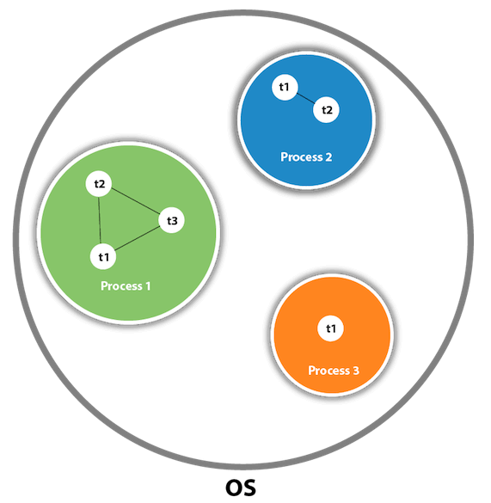
What is Thread in java
A thread is a lightweight subprocess,
the smallest unit of processing.
It is a separate path of execution.
Threads are independent.
If there occurs exception in one thread,
it doesn't affect other threads.
It uses a shared memory area.

Slide 7
Java Thread Methods
S.N. | Modifier and Type | Method | Description
1) | void | start() | It is used to start the execution of the thread.
2) | void | run() | It is used to do an action for a thread.
3) | static void | sleep() | It sleeps a thread for the specified amount of time.
4) | static Thread | currentThread() | It returns a reference to the currently executing thread object.
5) | void | join() | It waits for a thread to die.
6) | int | getPriority() | It returns the priority of the thread.
7) | void | setPriority() | It changes the priority of the thread.
8) | String | getName() | It returns the name of the thread.
9) | void | setName() | It changes the name of the thread.
10) | long | getId() | It returns the id of the thread.
11) | boolean | isAlive() | It tests if the thread is alive.
12) | static void | yield() | It causes the currently executing thread object to pause and allow other threads to execute temporarily.
13) | void | suspend() | It is used to suspend the thread.
14) | void | resume() | It is used to resume the suspended thread.
15) | void | stop() | It is used to stop the thread.
16) | void | destroy() | It is used to destroy the thread group and all of its subgroups.
17) | boolean | isDaemon() | It tests if the thread is a daemon thread.
18) | void | setDaemon() | It marks the thread as daemon or user thread.
19) | void | interrupt() | It interrupts the thread.
20) | boolean | isinterrupted() | It tests whether the thread has been interrupted.

Slide 8
Life cycle of a Thread (Thread States)
New: The thread is in new state if you create an instance of Thread class but before the invocation of start() method.
Runnable: The thread is in runnable state after invocation of start() method, but the thread scheduler has not selected it to be the running thread.
Running: The thread is in running state if the thread scheduler has selected it.
Non-Runnable (Blocked): This is the state when the thread is still alive, but is currently not eligible to run.
Terminated: A thread is in terminated or dead state when its run() method exits.

Slide 9
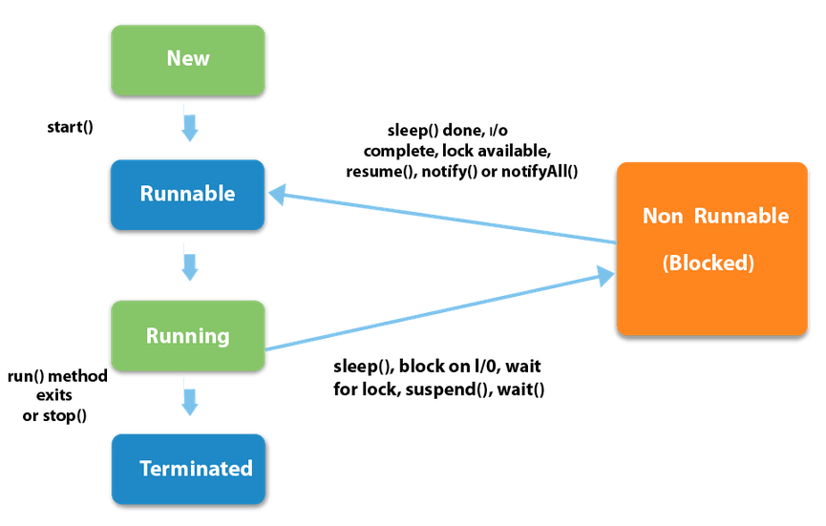
Life cycle of a Thread (Thread States)

Slide 10
How to create thread
There are two ways to create a thread:
By extending Thread class
By implementing Runnable interface.

Slide 11
1. Thread class
Commonly used methods of Thread class:
public void run(): is used to perform action for a thread.
public void start(): starts the execution of the thread.JVM calls the run() method on the thread.
public void sleep(long miliseconds): Causes the currently executing thread to sleep (temporarily cease execution) for the specified number of milliseconds.
public void join(): waits for a thread to die.
public void join(long miliseconds): waits for a thread to die for the specified miliseconds.
public int getPriority(): returns the priority of the thread.
public int setPriority(int priority): changes the priority of the thread.
public String getName(): returns the name of the thread.
public void setName(String name): changes the name of the thread.
public Thread currentThread(): returns the reference of currently executing thread.
public int getId(): returns the id of the thread.
public Thread.State getState(): returns the state of the thread.
public boolean isAlive(): tests if the thread is alive.
public void yield(): causes the currently executing thread object to temporarily pause and allow other threads to execute.
public void suspend(): is used to suspend the thread(depricated).
public void resume(): is used to resume the suspended thread(depricated).
public void stop(): is used to stop the thread(depricated).

Slide 12
Java Thread Example by extending Thread class
class Multi extends Thread {
public void run() {
System.out.println("thread is running...");
}
public static void main(String args[]) {
Multi t1=new Multi();
t1.start();
}
}
Output:
thread is running...
Notes:
start() method of Thread class is used to start a newly created thread. It performs following tasks: A new thread starts(with new callstack).
The thread moves from New state to the Runnable state.
When the thread gets a chance to execute, its target run() method will run.

Slide 13
2. Runnable interface
The Runnable interface should be implemented by any class whose instances are intended to be executed by a thread. Runnable interface have only one method named run().
public void run(): is used to perform action for a thread.
Notes:
Runnable is an interface in Java used to define a task that can be executed by a thread.
It has only one method:
public void run();
When a class implements Runnable, it must provide the implementation of the run() method.
You pass an instance of that class to a Thread object, which then executes the run() method in a new thread.

Slide 14
Java Thread Example by implementing Runnable interface
class ABC implements Runnable {
public void run() {
System.out.println("thread is running...");
}
public static void main(String args[]) {
ABC a1=new ABC();
Thread t1 =new Thread(a1);
t1.start();
}
}
Output:
thread is running...
Notes:
If you are not extending the Thread class,your class object would not be treated as a thread object.So you need to explicitely create Thread class object.We are passing the object of your class that implements Runnable so that your class run() method may execute.
The program starts from the main method.
An object a1 of class ABC is created — this represents the task to run.
A new Thread object t1 is created, and the Runnable object a1 is passed to it.
Calling t1.start() tells the JVM to start a new thread.
This new thread calls the run() method of a1, printing "thread is running...".
The main thread and this new thread run concurrently.

Slide 15
Thread Priority
Each thread have a priority. Priorities are represented by a number between 1 and 10. In most cases, thread scheduler schedules the threads according to their priority (known as preemptive scheduling). But it is not guaranteed because it depends on JVM specification that which scheduling it chooses.
3 constants defined in Thread class:
public static int MIN_PRIORITY
public static int NORM_PRIORITY
public static int MAX_PRIORITY
Default priority of a thread is 5 (NORM_PRIORITY). The value of MIN_PRIORITY is 1 and the value of MAX_PRIORITY is 10.

Slide 16
Example of priority of a Thread
class TestMultiPriority1 extends Thread {
public void run() {
System.out.println("running thread name is:"+Thread.currentThread().getName());
System.out.println("running thread priority is:"+Thread.currentThread().getPriority());
}
public static void main(String args[]) {
TestMultiPriority1 m1=new TestMultiPriority1();
TestMultiPriority1 m2=new TestMultiPriority1();
m1.setPriority(Thread.MIN_PRIORITY);
m2.setPriority(Thread.MAX_PRIORITY);
m1.start();
m2.start();
}
}
Output:
running thread name is:Thread-0 running thread priority is:10 running thread name is:Thread-1 running thread priority is:1

Slide 17
Main thread: Daemon Thread
Daemon thread in java is a service provider thread that provides services to the user thread. Its life depend on the mercy of user threads i.e. when all the user threads dies, JVM terminates this thread automatically.
There are many java daemon threads running automatically e.g. gc, finalizer etc.
You can see all the detail by typing the jconsole in the command prompt. The jconsole tool provides information about the loaded classes, memory usage, running threads etc.
Notes:
A Daemon Thread is a background service thread that provides support to user threads. It runs in the background and does not prevent the JVM from exiting once all user (non-daemon) threads are finished.

Slide 18
Daemon Thread
It provides services to user threads for background supporting tasks. It has no role in life than to serve user threads.
Its life depends on user threads.
It is a low priority thread.

Slide 19
Example of Daemon thread in java
public class TestDaemonThread1 extends Thread{
public void run(){
if(Thread.currentThread().isDaemon()){//checking for daemon thread
System.out.println("daemon thread work");
}
else{
System.out.println("user thread work");
}
}
public static void main(String[] args){
TestDaemonThread1 t1=new TestDaemonThread1();//creating thread
TestDaemonThread1 t2=new TestDaemonThread1();
TestDaemonThread1 t3=new TestDaemonThread1();
t1.setDaemon(true);//now t1 is daemon thread
t1.start();//starting threads
t2.start();
t3.start();
}
}
Output:
daemon thread work
user thread work
user thread work

Slide 20


Slide 21
Synchronization
Synchronization in java is the capability to control the access of multiple threads to any shared resource.
Java Synchronization is better option where we want to allow only one thread to access the shared resource.
Why use Synchronization
The synchronization is mainly used to
To prevent thread interference.
To prevent consistency problem.
Types of Synchronization
There are two types of synchronization
Process Synchronization
Thread Synchronization

Slide 22
Thread synchronization
There are two types of thread synchronization mutual exclusive and inter-thread communication.
Mutual Exclusive
Synchronized method.
Synchronized block.
static synchronization.
Cooperation (Inter-thread communication in java)
Concept of Lock in Java
Synchronization is built around an internal entity known as the lock or monitor. Every object has an lock associated with it. By convention, a thread that needs consistent access to an object's fields has to acquire the object's lock before accessing them, and then release the lock when it's done with them.
From Java 5 the package java.util.concurrent.locks contains several lock implementations.

Slide 23
Understanding the problem without Synchronization
class Table {
void printTable(int n) { //method not synchronized
for(int i=1;i<=5;i++) {
System.out.println(n*i);
try {
Thread.sleep(400);
} catch(Exception e) { System.out.println(e); }
}
}
}
class MyThread1 extends Thread {
Table t;
MyThread1(Table t) {
this.t=t;
}
public void run() {
t.printTable(5);
}
}
class MyThread2 extends Thread {
Table t;
MyThread2(Table t) {
this.t=t;
}
public void run() {
t.printTable(100);
}
}
class TestSynchronization1 {
public static void main(String args[]) {
Table obj = new Table();//only one object
MyThread1 t1=new MyThread1(obj);
MyThread2 t2=new MyThread2(obj);
t1.start();
t2.start();
}
}
Output:
5
100
10
200
15
300
20
400
25
500

Slide 24
Java synchronized method
class Table {
synchronized void printTable(int n) { //synchronized
for(int i=1;i<=5;i++) {
System.out.println(n*i);
try {
Thread.sleep(400);
} catch(Exception e) { System.out.println(e); }
}
}
}
class MyThread1 extends Thread {
Table t;
MyThread1(Table t) {
this.t=t;
}
public void run() {
t.printTable(5);
}
}
class MyThread2 extends Thread {
Table t;
MyThread2(Table t) {
this.t=t;
}
public void run() {
t.printTable(100);
}
}
class TestSynchronization2 {
public static void main(String args[]) {
Table obj = new Table();//only one object
MyThread1 t1=new MyThread1(obj);
MyThread2 t2=new MyThread2(obj);
t1.start();
t2.start();
}
}
Output:
5
10
15
20
25
100
200
300
400
500
Notes:
If you declare any method as synchronized, it is known as synchronized method.
Synchronized method is used to lock an object for any shared resource.
When a thread invokes a synchronized method, it automatically acquires the lock for that object and releases it when the thread completes its task.

Slide 25
Inter-thread communication in Java
Inter-thread communication or Co-operation is all about allowing synchronized threads to communicate with each other.
Cooperation (Inter-thread communication) is a mechanism in which a thread is paused running in its critical section and another thread is allowed to enter (or lock) in the same critical section to be executed.It is implemented by following methods of Object class:
wait()
notify()
notifyAll()
Notes:
1) wait() method
Causes current thread to release the lock and wait until either another thread invokes the notify() method or the notifyAll() method for this object, or a specified amount of time has elapsed.
The current thread must own this object's monitor, so it must be called from the synchronized method only otherwise it will throw exception.
2) notify() method
Wakes up a single thread that is waiting on this object's monitor. If any threads are waiting on this object, one of them is chosen to be awakened. The choice is arbitrary and occurs at the discretion of the implementation. Syntax:
public final void notify()
3) notifyAll() method
Wakes up all threads that are waiting on this object's monitor. Syntax:
public final void notifyAll()

Slide 26
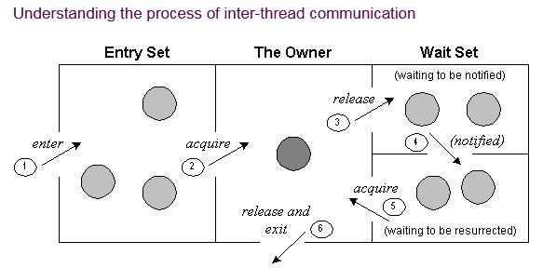
The point to point explanation of the above diagram is as follows:
Threads enter to acquire lock.
Lock is acquired by on thread.
Now thread goes to waiting state if you call wait() method on the object. Otherwise it releases the lock and exits.
If you call notify() or notifyAll() method, thread moves to the notified state (runnable state).
Now thread is available to acquire lock.
After completion of the task, thread releases the lock and exits the monitor state of the object.

Slide 27
Creating multiple threads using is Alive() and join()
The isAlive() method returns true if the thread upon which it is called is still running otherwise it returns false.
final boolean isAlive()
But, join() method is used more commonly than isAlive(). This method waits until the thread on which it is called terminates.
final void join() throws InterruptedException
final void join(long milliseconds) throws InterruptedException
Using join() method, we tell our thread to wait until the specified thread completes its execution. There are overloaded versions of join() method, which allows us to specify time for which you want to wait for the specified thread to terminate.
Notes:
isAlive() → checks if a thread is still running (true) or finished (false).
join() → makes the main thread wait until the given thread finishes execution.
Before starting, all threads are not alive.
After calling start(), they become alive.
After join(), main thread waits for them, and once finished, they are not alive again.
👉 This way, you can manage multiple threads properly.

Slide 28
Java isAlive method
public class MyThread extends Thread {
public void run() {
System.out.println("r1 ");
try {
Thread.sleep(500);
} catch(InterruptedException ie) { // do something }
System.out.println("r2 ");
}
public static void main(String[] args) {
MyThread t1=new MyThread();
MyThread t2=new MyThread();
t1.start();
t2.start();
System.out.println(t1.isAlive());
System.out.println(t2.isAlive());
}
}
Output:
r1
true
true
r1
r2
r2
Notes:
Output behavior:
Before starting → all threads return false for isAlive().
After starting → they return true (running/ready to run).
After join → they return false again (completed).
join() ensures the main thread waits until all child threads finish.

Slide 29
Thread without join() method
public class MyThread extends Thread {
public void run() {
System.out.println("r1 ");
try {
Thread.sleep(500);
} catch(InterruptedException ie){ } System.out.println("r2 ");
}
public static void main(String[] args) { MyThread t1=new MyThread();
MyThread t2=new MyThread();
t1.start();
t2.start();
}
}
Output:
r1
r1
r2
r2
Notes:
In this above program two thread t1 and t2 are created. t1 starts first and after printing "r1" on console thread t1 goes to sleep for 500 ms. At the same time Thread t2 will start its process and print "r1" on console and then go into sleep for 500 ms. Thread t1 will wake up from sleep and print "r2" on console similarly thread t2 will wake up from sleep and print "r2" on console. So you will get output like r1 r1 r2 r2.

Slide 30
Thread with join() method
public class MyThread extends Thread {
public void run() {
System.out.println("r1 ");
try {
Thread.sleep(500);
} catch(InterruptedException ie){ } System.out.println("r2 ");
}
public static void main(String[] args) {
MyThread t1=new MyThread();
MyThread t2=new MyThread();
t1.start();
try {
t1.join(); //Waiting for t1 to finish }catch(InterruptedException ie){}
t2.start();
} }
Output:
r1
r2
r1
r2
Notes:
In this above program join() method on thread t1 ensures that t1 finishes it process before thread t2 starts.

Slide 31

(Assistant Professor) Department of Computer Engineering Sinhgad Academy of Engineering, Kondhwa, Pune

